Slide 1
Programming for Image Processing/Analysis and Visualization using
The Visualization Toolkit
http://noodle.med.yale.edu/seminar/seminar.html
Xenios Papademetris
papad@noodle.med.yale.edu
BML 325, 5-7294

Slide 2
Course Structure
Using VTK using scripting languages
  Understand Toolkit Structure
  Use existing algorithms (incl. local extensions)
  Learn Tcl/Tk
Extending VTK
  C++/Object Oriented Programming/Design
  Cross-Platform Issues
  Coding Guidelines

Slide 3
Schedule – Part 1
Introduce VTK (today)
Introduce Tcl/Tk
Simple Visualization Tasks
Simple Image/Surface Manipulation
More on Images and Volume Rendering
Local Extensions
  (Marcel: Itcl/Itk/Iwidgets, more advanced GUI generation etc.)

Slide 4
Schedule – Part 2
C++ Fundamentals, Pointers/Classes
Object Oriented Programming
Adding new VTK Commands/Cmake
More on Images and Surfaces
Case Study I – Computing t-maps in fMRI
Case Study II -- Iterative Closest Point surface matching
Case Study III – Linear Mutual Information Multimodal Registration

Slide 5
VTK Pipeline (I)
File Output
Sources
Filters
Mappers
Props
vtkDataSet
vtkDataSet

Slide 6
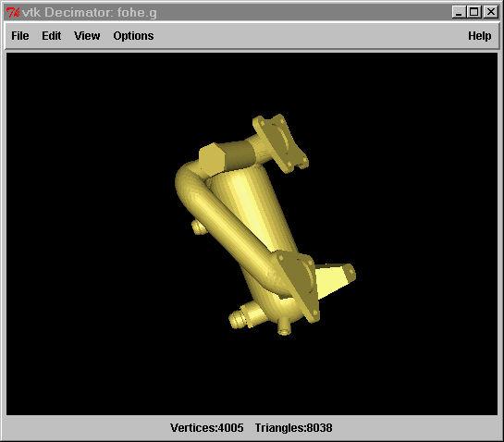
VTK Pipeline II
Props
Renderer
Render
Window
Props
Props
(e.g. Actor/Volume)
vtkCamera,
vtkLight
vtkRenderWindowInteractor
vtkProperty

Slide 7
Data Representation
(vtkDataSet)
Point Attributes
(vtkPointData)
Point Properties
(e.g. intensity)
Points
(vtkPoints)
Define Location
Arrays of
Numbers
(one per point
or cell)
vtkDataArray
Data Set
Cells
(vtkCellArray)
Define Topology
Cell Attributes
(vtkPointData)
Point Properties
(e.g. normal)

Slide 8
Cells specify Topology
Polygon
Tetrahedron
Hexahedron
Triangle
Line
etc

Slide 9
Cells
Cell is defined by an ordered list of points
  Triangle, quadrilateral points specified counter clockwise
  Others as shown
3
6
7
5
4
1
3
2
2
Hexahedron
1
Tetrahedron
0
0

Slide 10
VTK Dataset Types
vtkStructuredPoints
vtkRectilinearGrid
vtkStructuredGrid
vtkPolyData
vtkUnstructuredGrid

Slide 11
Datasets
Organizing structure plus attributes
  Structured points
  Rectilinear Grid
  Structured Grid

Slide 12
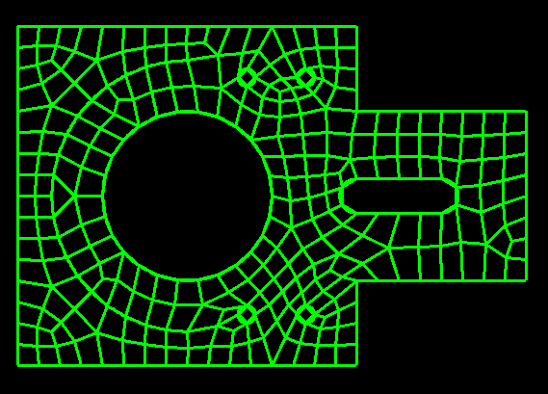
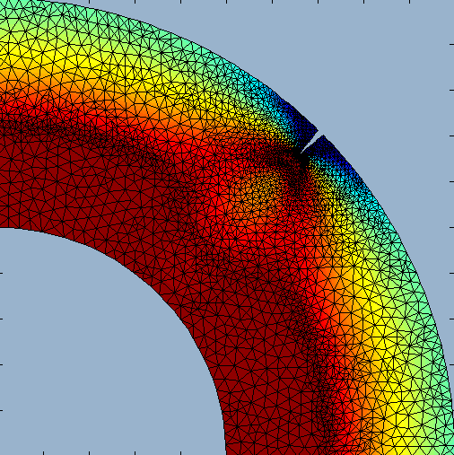
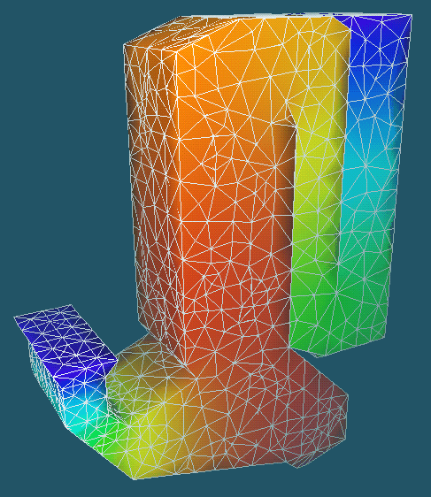
Unstructured Grid
A collection of vertices, edges, faces and cells whose connectivity information must be explicitly stored

Slide 13
Data Attributes Assigned to points or cells
Scalars
Vector
  Magnitude and direction
Normal
  a vector of magnitude 1
  Used for lighting
Texture Coordinate
  Mapping data points into a texture space
Tensor

Slide 14
Object Oriented Programming
Impossible to Cover in 10 minutes … but
Traditional programming (i.e. C,Fortran,Matlab) is procedural:
If we have matrix a
to print it we do print(a), disp(a) etc,
Data/Procedures are separate, data is dumb

Slide 15
Object Oriented Programming II
In OOP data is “intelligent” i.e. data structures encapsulate procedures i.e.
If we have matrix a
to print it we do a.print()
Procedures are embedded within the data structure definition (called methods)
Lots of good reasons for this …

Slide 16
Object Oriented Programming III
Data structures are classes: e.g. in C++
class Matrix3x3 {
float a[3][3];
public:
void Print();
void Invert();
void Load(char* filename);
etc.
}
To use:
Matrix3x3 a;
a.Load(`a.matr’);
a.Print();

Slide 17
OOP IV -- Inheritance
Consider now need to change file format for matrix:
INHERIT new class myMatrix3x3 from Matrix3x3 and override Print()
class myMatrix3x3 : public Matrix3x3 {
public:
void Load(char* filename);
}
To use:
myMatrix3x3 a;
a.Load(`a.matr’);
a.Print(); This calls the Print function from Matrix3x3 class

Slide 18
VTK Hierarchy
To understand VTK structure need to look at class hierarchy
Common functionality implemented in base-level (parent) classes
Specialized functionality implemented in lower-level (children) classes

Slide 19
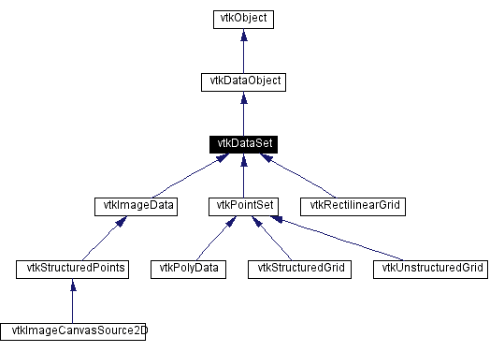
VTK Hierarchy
To understand man pages http://www.vtk.org/doc/release/4.0/html/classes.html

